Slide 1
EMPLOYEE MANAGEMENT SYSTEM
Dibyajyoti Bhuyan

Slide 2
Introduction
Overview: The Employee Management System (EMS) is a software application designed to streamline the management of employee records.
Purpose: To enable efficient handling of employee data, including addition, modification, deletion, and retrieval of employee information.
Scope: This system supports both administrative functions and employee self-management.

Slide 3
Key Features
Admin Operations:
Login using id and password
Add a new Employee
View a particular Employee Details
View Details of all employees.
Update employee details by their id.
Delete Employees from the system by their id.

Slide 4
Key Features
Employee Operations:
Login using id and password
View their details
Update their details

Slide 5
Technology Used
Python scripts utilizing MySQL Connector for database interactions.
MySQL, managing employee data and ensuring data integrity.

Slide 6
Interaction Flows
The user will first be asked to identify their role as either an Admin or an Employee. Based on their selection, they will then be directed to proceed with the relevant actions or operations appropriate for their role.
Admin Actions:
Log in: Admin credentials.
Menu Selection: Choose from the admin menu (add, view, modify, delete employees).
Execute Operation: Perform the selected action.
Employee Actions:
Log in: Employee email and password.
Menu Selection: View or modify personal details.
Execute Operation: Perform the selected action.

Slide 7
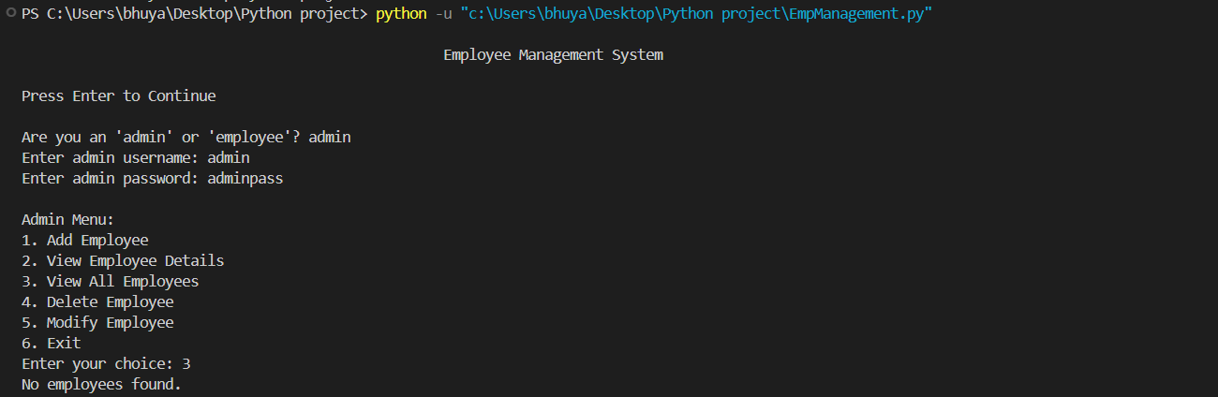
Implementations
Login by Admin and viewing all employees

Slide 8
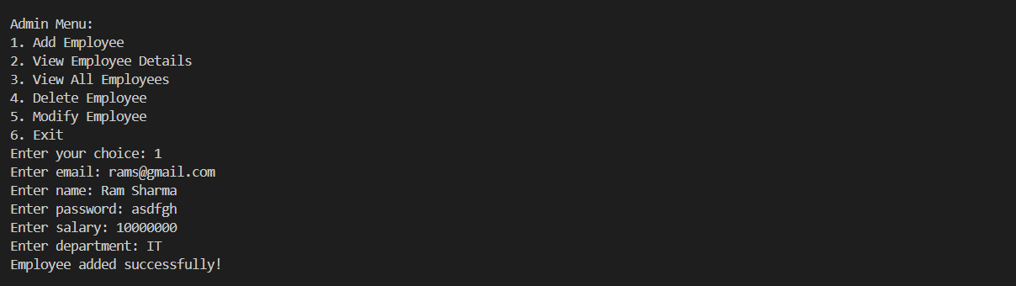
Implementations
Adding new employee

Slide 9
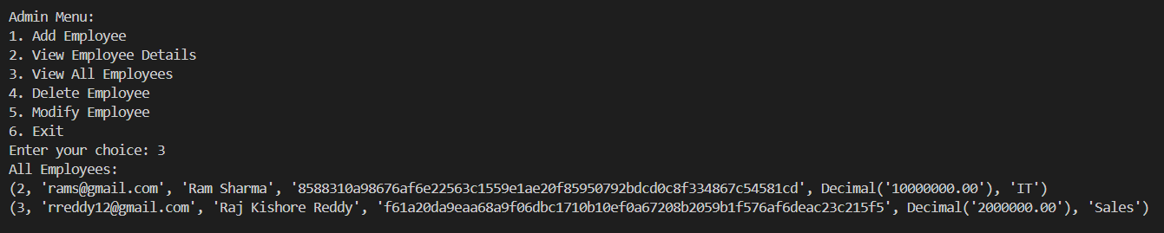
Implementations
Viewing all Employee Details

Slide 10
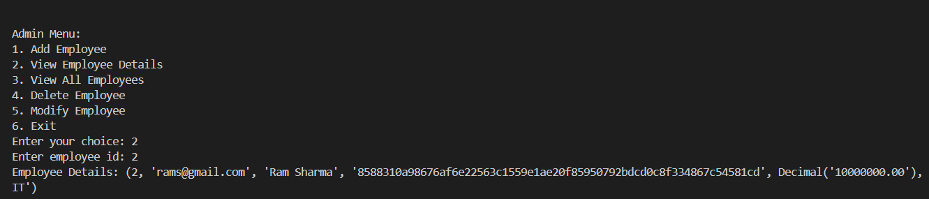
Implementations
Viewing a single Employee by ID

Slide 11
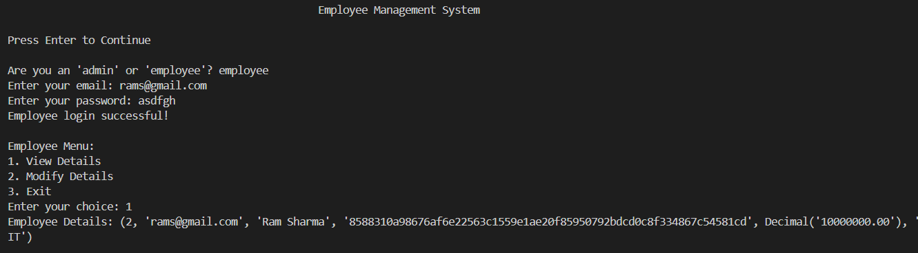
Implementations
Employee Login and viewing of details

Slide 12
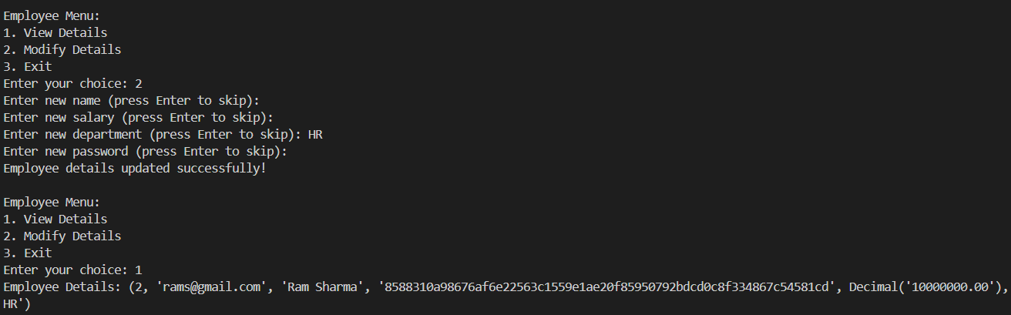
Implementations
Employee Modifying their data

Slide 13
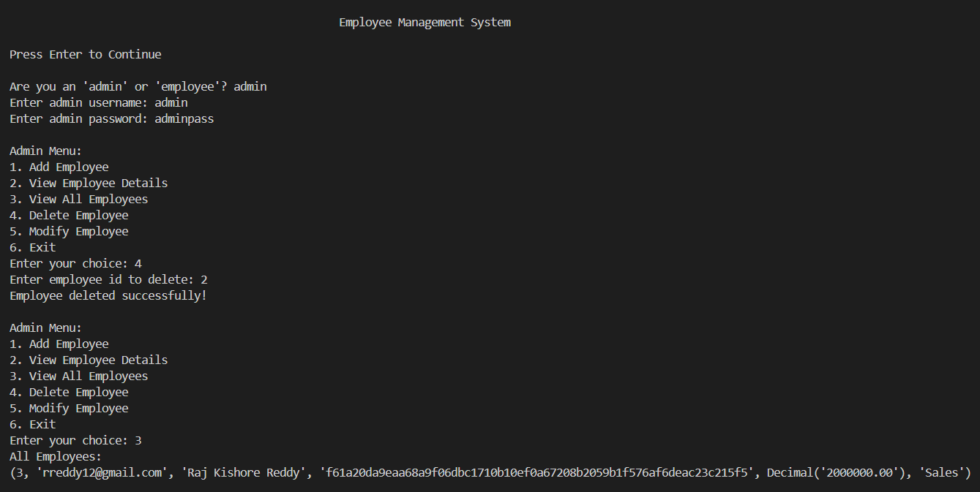
Implementations
Deletion of an Employee by the Admin

Slide 14
Thank
You

